Slide 1
More on
Divide and Conquer

Slide 2
The divide-and-conquer design paradigm
1. Divide the problem (instance)
into subproblems.
2. Conquer the subproblems by
solving them recursively.
3. Combine subproblem solutions.

Slide 3
Example: merge sort
1. Divide: Trivial.
2. Conquer: Recursively sort 2 subarrays.
3. Combine: Linear-time merge.
T(n) = 2 T (n/2) + O (n)
# subproblems
work dividing
and combining
subproblem size

Slide 4
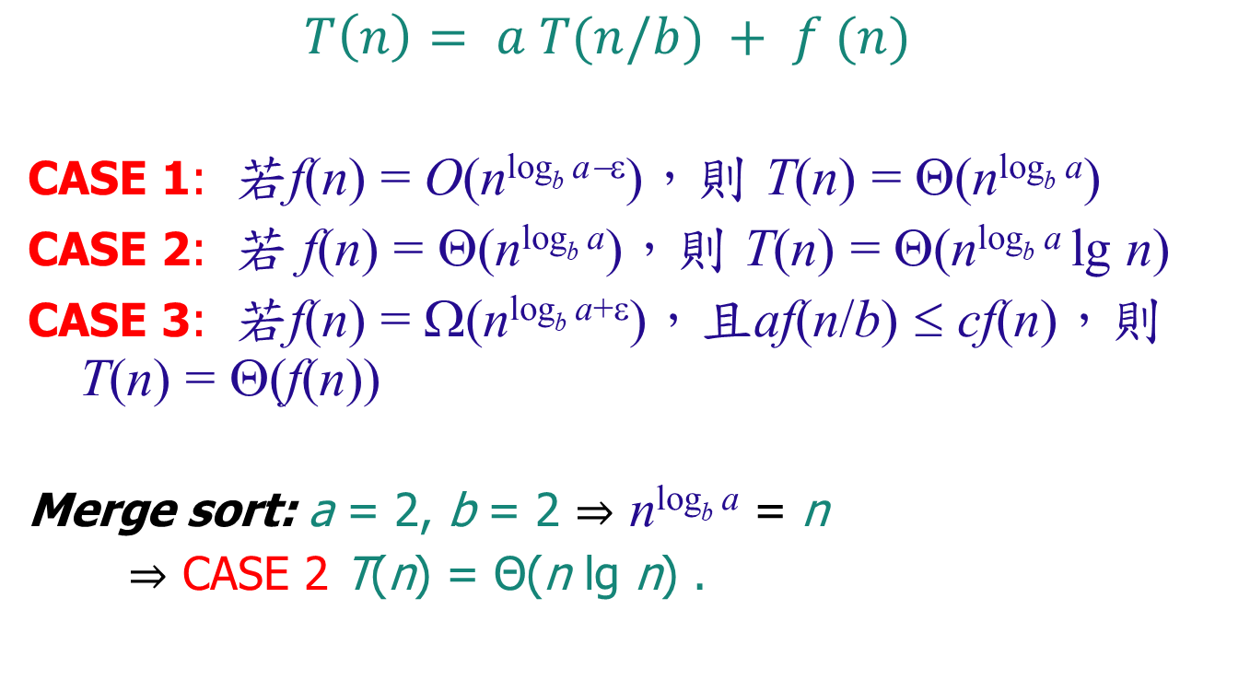
Master theorem:
$T\left(n\right)= a T(n/b) + f (n)$
CASE 1: 若f(n) = O(n^{logb a−ε})，則 T(n) = Θ(n^{logb a})
CASE 2: 若 f(n) = Θ(n^{logb a})，則 T(n) = Θ(n^{logb a} lg n)
CASE 3: 若f(n) = Ω(n^{logb a+ε})，且af(n/b) ≤ cf(n)，則 T(n) = Θ(f(n))
Merge sort: a = 2, b = 2 ⇒ n^{logb a} = n
⇒ CASE 2 T(n) = Θ(n lg n) .

Slide 5
Binary search
Find an element in a sorted array:
1. Divide: Check middle element.
2. Conquer: Recursively search 1 subarray.
3. Combine: Trivial.
Example: Find 9
3 5 7 8 9 12 15

Slide 6
Binary search
Find an element in a sorted array:
1. Divide: Check middle element.
2. Conquer: Recursively search 1 subarray.
3. Combine: Trivial.
Example: Find 9
3 5 7 8 9 12 15

Slide 7
Binary search
Find an element in a sorted array:
1. Divide: Check middle element.
2. Conquer: Recursively search 1 subarray.
3. Combine: Trivial.
Example: Find 9
3 5 7 8 9 12 15

Slide 8
Binary search
Find an element in a sorted array:
1. Divide: Check middle element.
2. Conquer: Recursively search 1 subarray.
3. Combine: Trivial.
Example: Find 9
3 5 7 8 9 12 15

Slide 9
Binary search
Find an element in a sorted array:
1. Divide: Check middle element.
2. Conquer: Recursively search 1 subarray.
3. Combine: Trivial.
Example: Find 9
3 5 7 8 9 12 15

Slide 10
Binary search
Find an element in a sorted array:
1. Divide: Check middle element.
2. Conquer: Recursively search 1 subarray.
3. Combine: Trivial.
Example: Find 9
3 5 7 8 9 12 15

Slide 11
Recurrence for binary search
T(n) = 1 T(n/2) + Θ(1)
a=1, b=2, n^{logb a}= n⁰ ⇒ CASE 2
⇒ T(n) = Θ(lg n) .
# subproblems
work dividing
and combining
subproblem size

Slide 12
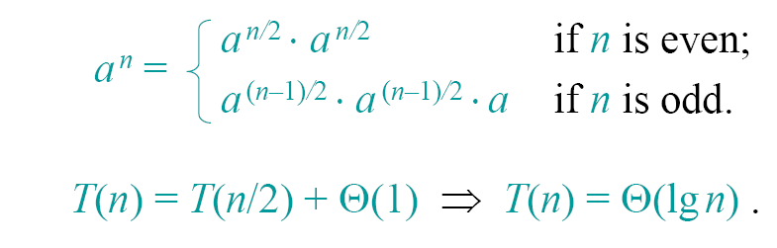
Powering a number
Problem: Compute a^{n}, where n ∈ N.
Naive algorithm: Θ(n).
Divide-and-conquer algorithm:

Slide 13
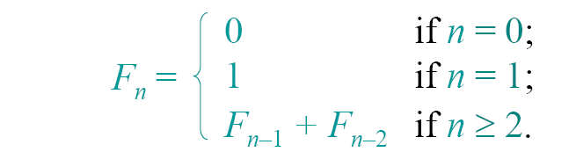

Fibonacci numbers
Recursive definition:
0 1 1 2 3 5 8 13 21 34 …
Naive recursive algorithm: Ω( φ^{n})
(exponential time), where
is the golden ratio.

Slide 14

Computing Fibonacci numbers
Naive recursive squaring:
rounded to the nearest integer. 5
• Recursive squaring: Θ(lg n) time.
• This method is unreliable, since floating-point
arithmetic is prone to round-off errors.
Bottom-up:
• Compute F0, F1, F2, …, Fn in order, forming
each number by summing the two previous.
• Running time: Θ(n).

Slide 15
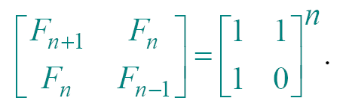
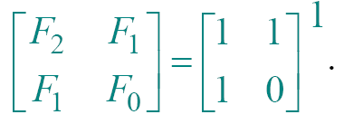
Recursive squaring
Theorem:
Algorithm: Recursive squaring.
Time = Θ(lg n) .
Proof of theorem. (Induction on n.)
Base (n = 1):

Slide 16
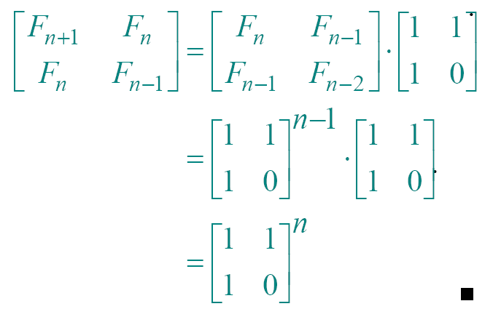
Recursive squaring
Inductive step (n ≥ 2):

Slide 17
Maximum subarray problem
1 | 2 | 3 | 4 | 5 | 6 | 7 | 8 | 9 | 10 | 11 | 12 | 13 | 14 | 15 | 16
13 | -3 | -25 | 20 | -3 | -16 | -23 | 18 | 20 | -7 | 12 | -5 | -22 | 15 | -4 | 7
Input: An Array of numbers
Output: A subarray with the maximum sum
Observation:
low
mid
high

Slide 18
low
mid
high
Subproblem: Find a maximum subarray of A[low .. high]. In original call, low =1, high = n.
Divide the subarray into two subarrays. Find the midpoint mid of the subarrays, and consider the subarrays A[low ..mid] And A[mid +1..high]
Conquer by finding a maximum subarrays of A[low ..mid] and A[mid+1..high].
Combine by finding a maximum subarray that crosses the midpoint, and using the best solution out of the three.

Slide 19
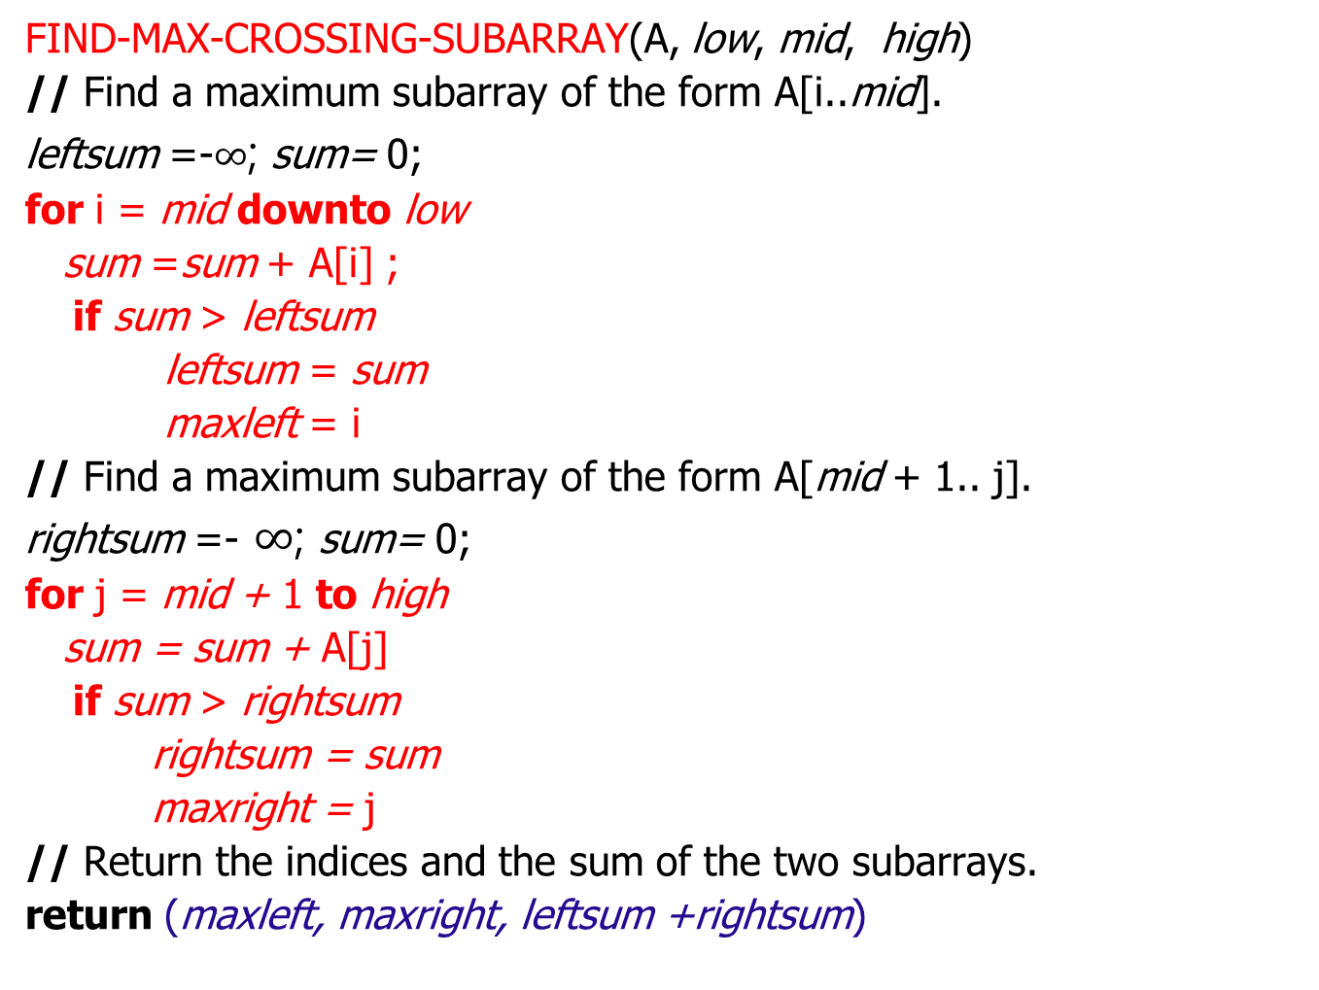
FIND-MAX-CROSSING-SUBARRAY(A, low, mid, high)
// Find a maximum subarray of the form A[i..mid].
leftsum =-$∞$; sum= 0;
for i = mid downto low
sum =sum + A[i] ;
if sum > leftsum
leftsum = sum
maxleft = i
// Find a maximum subarray of the form A[mid + 1.. j].
rightsum =- $∞$; sum= 0;
for j = mid + 1 to high
sum = sum + A[j]
if sum > rightsum
rightsum = sum
maxright = j
// Return the indices and the sum of the two subarrays.
return (maxleft, maxright, leftsum +rightsum)

Slide 20
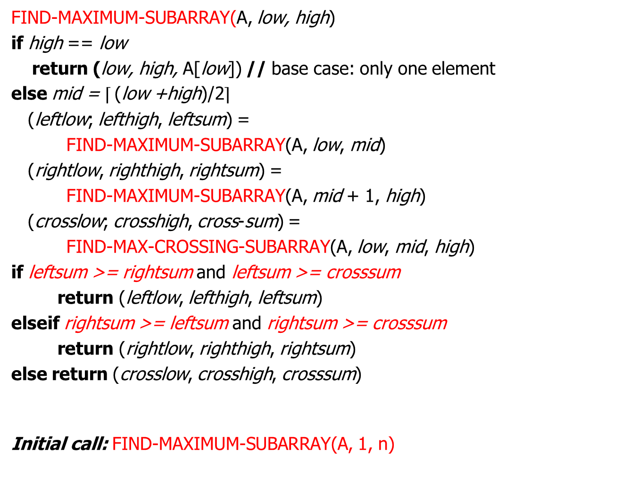


FIND-MAXIMUM-SUBARRAY(A, low, high)
if high == low
return (low, high, A[low]) // base case: only one element
else mid = $⌈$(low +high)/2$⌉$
(leftlow; lefthigh, leftsum) =
FIND-MAXIMUM-SUBARRAY(A, low, mid)
(rightlow, righthigh, rightsum) =
FIND-MAXIMUM-SUBARRAY(A, mid + 1, high)
(crosslow; crosshigh, cross-sum) =
FIND-MAX-CROSSING-SUBARRAY(A, low, mid, high)
if leftsum >= rightsum and leftsum >= crosssum
return (leftlow, lefthigh, leftsum)
elseif rightsum >= leftsum and rightsum >= crosssum
return (rightlow, righthigh, rightsum)
else return (crosslow, crosshigh, crosssum)
Initial call: FIND-MAXIMUM-SUBARRAY(A, 1, n)
$$T(n)=2T(n/2)+Θ (n)$$
$$T(n)=Θ (n log⁡n)$$

Slide 21

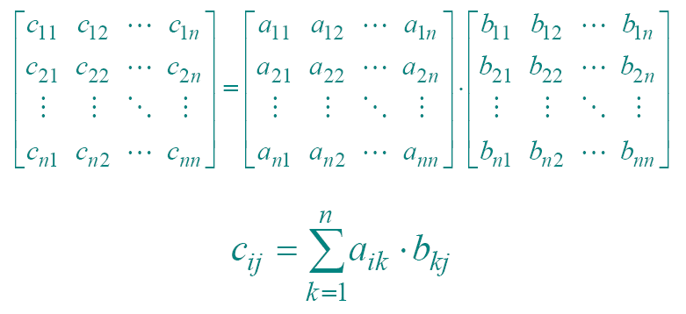
Matrix multiplication
Input:
Output:

Slide 22
Standard algorithm
for i ← 1 to n
do for j ← 1 to n
do c_{ij} ← 0
for k ← 1 to n
do c_{ij} ← c_{ij} + a_{ik} ⋅b_{kj}
Running time = Θ(n³)

Slide 23
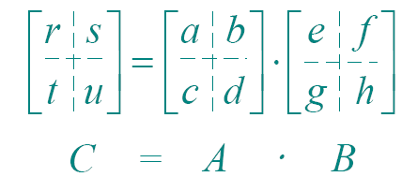

Divide-and-conquer algorithm
IDEA:
n×n matrix = 2×2 matrix of (n/2)×(n/2) submatrices:
8 mults of (n/2)×(n/2) submatrices
4 adds of (n/2)×(n/2) submatrices
$$\left\{\begin{aligned}r=ae+bg \\ s=af+bh \\ t=ce+dg \\ u=cf+dh\end{aligned}\right.$$

Slide 24
Analysis of D&C algorithm
T(n) = 8 T(n/2) + Θ(n²)
a=8, b=2, n^{logb a}= n³ ⇒ CASE 1 ⇒ T(n) = Θ(n³) .
No better than the ordinary algorithm.
# subproblems
work dividing
and combining
subproblem size

Slide 25
Strassen’s idea
• Multiply 2×2 matrices with only 7 recursive
P1 = a ⋅ ( f – h) r = P5 + P4 – P2 + P6
P2 = (a + b) ⋅ h s = P1 + P2
P3 = (c + d) ⋅ e t = P3 + P4
P4 = d ⋅ (g – e) u = P5 + P1 – P3 – P7
P5 = (a + d) ⋅ (e + h) 7 mults, 18 adds/subs.
P6 = (b – d) ⋅ (g + h) Note: No reliance on
P7 = (a – c) ⋅ (e + f ) commutativity of mult!

Slide 26

Strassen’s idea
$$\left\{\begin{aligned}r=ae+bg \\ s=af+bh \\ t=ce+dg \\ u=cf+dh\end{aligned}\right.$$
• Multiply 2×2 matrices with only 7 recursive
P1 = a ⋅ ( f – h) r = P5 + P4 – P2 + P6
P2 = (a + b) ⋅ h = (a+d)(e+h)
P3 = (c + d) ⋅ e + d(g-e)-(a+b)h
P4 = d ⋅ (g – e) +(b-d)(g+h)
P5 = (a + d) ⋅ (e + h) = ae+ah+de+dh
P6 = (b – d) ⋅ (g + h) +dg-de-ah-bh
P7 = (a – c) ⋅ (e + f ) +bg+bh-dg-dh
=ae + bg

Slide 27
Strassen’s algorithm
1. Divide: Partition A and B into
(n/2)×(n/2) submatrices. Form terms
to be multiplied using + and – .
2. Conquer: Perform 7 multiplications of
(n/2)×(n/2) submatrices recursively.
3. Combine: Form C using + and – on
(n/2)×(n/2) submatrices.
T(n) = 7 T(n/2) + Θ(n²)

Slide 28
Analysis of Strassen
T(n) = 7 T(n/2) + Θ(n2)
a=7, b=2, n^{logb a}= n^{lg7} ≈ n^{2.81} ⇒ CASE 1 ⇒ T(n) = Θ(n ^{lg 7}).
The number 2.81 may not seem much smaller than
3, but because the difference is in the exponent, the
impact on running time is significant. In fact,
Strassen’s algorithm beats the ordinary algorithm
on today’s machines for n ≥ 30 or so.
Best to date (of theoretical interest only): Θ(n^{2.376…}).

Slide 29
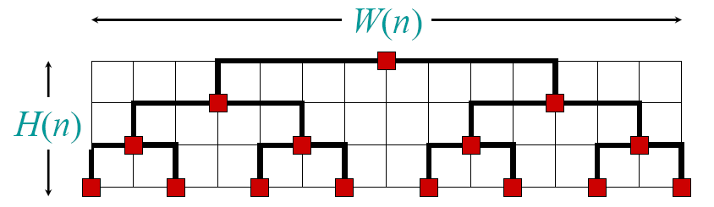
VLSI layout
Problem: Embed a complete binary tree
with n leaves in a grid using minimal area.
H(n) = H(n/2) + Θ(1) W(n) = 2W(n/2) + Θ(1)
= Θ(lg n) = Θ(n)
Area = Θ(n lg n)

Slide 30
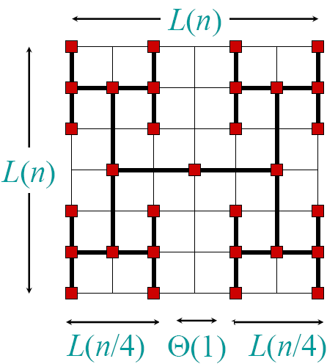
H-tree embedding
        L(n) = 2L(n/4) + Θ(1)
        = Θ(√n )
        Area = Θ(n)

Slide 31
Conclusion
• Divide and conquer is just one of several
powerful techniques for algorithm design.
• Divide-and-conquer algorithms can be analyzed using recurrences and the master method (so practice this math).
• Can lead to more efficient algorithms

